Slide 1
Serial Protocool

Slide 2
Agenda
Uart_Loopback
SPI_Flash
IIC_EEPROM

Slide 3
UART

Slide 4
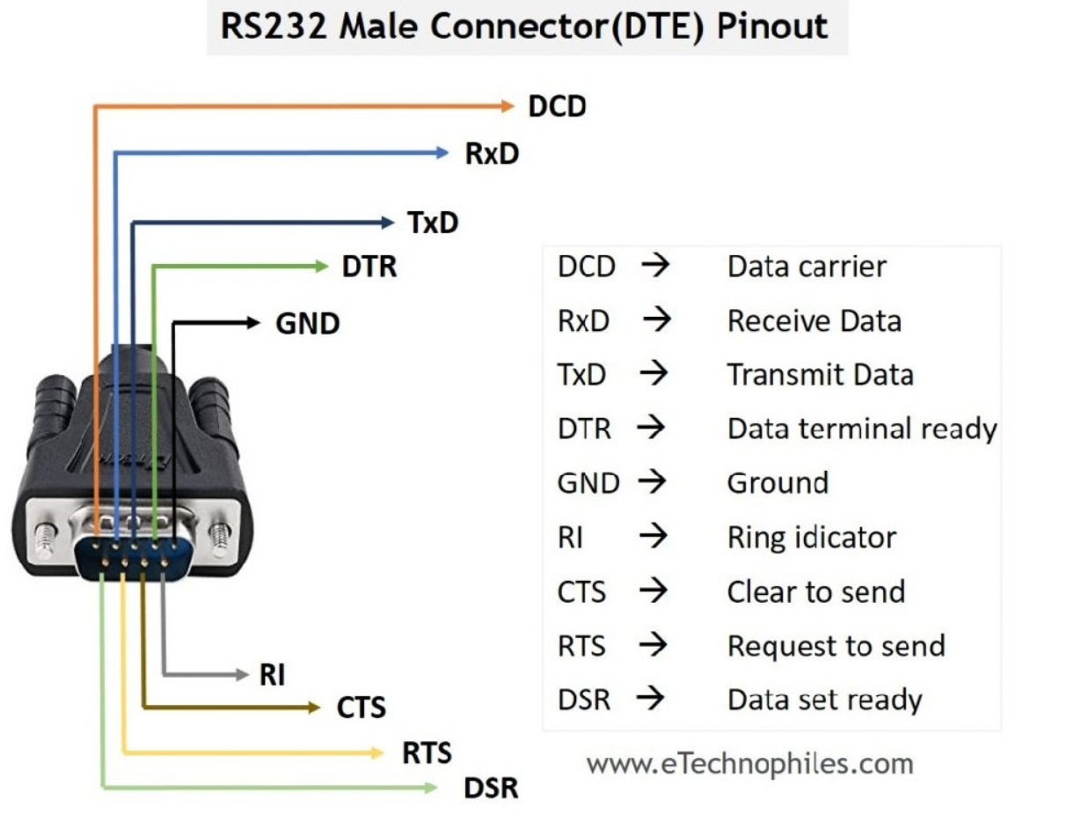
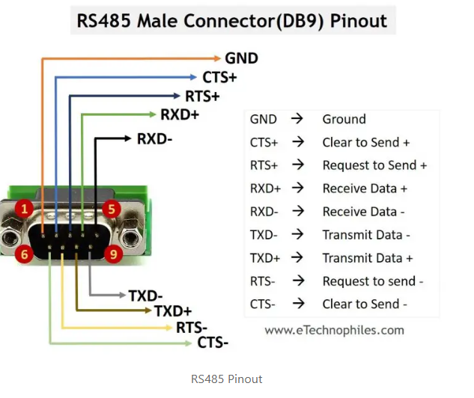
UART overview
全稱Universal Asynchronous Receiver/Transmitter，屬於異步Serial通信接口的統稱。
後續會做一個簡單的UART_LOOP實現Lab

Slide 5
RS232
RS232是全雙工(可同時讀寫)，並且使用單端信號
TX
RX
PC
Serial data
Parallel data
FPGA
RX
TX
校驗位
LSB
MSB

Slide 6
Baud Rate
以9600 Baud Rate為例，每秒傳送9600個bit 即 一個bit時間是104.16us。
且因為UART屬於異步通訊所以需要考量系統時鐘頻率。
BAUD_CNT_MAX = CLK_PERIOD / BAUD_BPS
舉例來說，如果時鐘頻率為50MHZ 配上9600 Baud Rate則一個bit位會花費約5208個時鐘週期
9600 Baud Rate
校驗位
LSB
MSB
104.16us

Slide 7
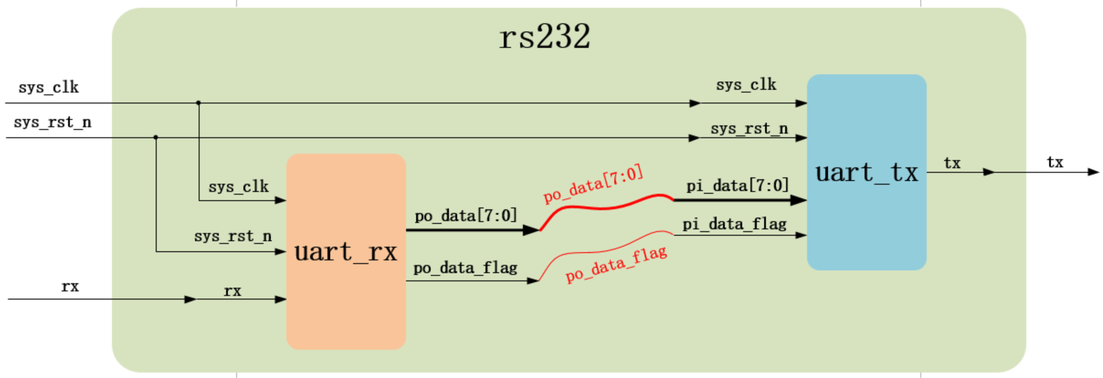
RS232 Hardware architecture

Slide 8
uart_rx
將Baud Rate 及時鐘週期拉出來方便更改
module uart_rx#(
parameter UART_BPS = 'd9600, // Baud Rate
parameter CLK_FREQ = 'd50_000_000 // Clock period
)(
input wire sys_clk , // 50MHz
input wire sys_rst_n ,
input wire rx , // Receive Data
output reg [7:0] po_data , // Parallel Data
output reg po_flag
);

Slide 9
uart_rx
BAUD_CNT_MAX 代表一個bit花費的時鐘週期
//localparam define
localparam BAUD_CNT_MAX = CLK_FREQ/UART_BPS ;
//reg define
reg rx_reg1 ;
reg rx_reg2 ;
reg rx_reg3 ;
reg start_flag ;
reg work_en ;
reg [12:0] baud_cnt ;
reg bit_flag ;
reg [3:0] bit_cnt ;
reg [7:0] rx_data ;
reg rx_flag ;

Slide 10
uart_rx
reg1讓兩邊的clock同步，後面兩個rx_reg是為了抑制抖動消除亞穩態
// Synchronize Clock Period
always@(posedge sys_clk or negedge sys_rst_n)
if(sys_rst_n == 1'b0)
rx_reg1 <= 1'b1;
else
rx_reg1 <= rx;
// Eliminate metastability
always@(posedge sys_clk or negedge sys_rst_n)
if(sys_rst_n == 1'b0)
rx_reg2 <= 1'b1;
else
rx_reg2 <= rx_reg1;
always@(posedge sys_clk or negedge sys_rst_n)
if(sys_rst_n == 1'b0)
rx_reg3 <= 1'b1;
else
rx_reg3 <= rx_reg2;

Slide 11
uart_rx
判斷真正的開始位
// Edge Detect
always@(posedge sys_clk or negedge sys_rst_n)
if(sys_rst_n == 1'b0)
start_flag <= 1'b0;
else if((~rx_reg2) && (rx_reg3) && (work_en == 1'b0))
start_flag <= 1'b1;
else
start_flag <= 1'b0;

Slide 12
uart_rx
判斷一次傳輸的bit數為8位
// Detect Recive 8 bit Rx_data
always@(posedge sys_clk or negedge sys_rst_n)
if(sys_rst_n == 1'b0)
work_en <= 1'b0;
else if(start_flag == 1'b1)
work_en <= 1'b1;
else if((bit_cnt == 4'd8) && (bit_flag == 1'b1))
work_en <= 1'b0;
else
work_en <= work_en;
// Count receive 8 bit Rx_data
always@(posedge sys_clk or negedge sys_rst_n)
if(sys_rst_n == 1'b0)
bit_cnt <= 4'b0;
else if((bit_cnt == 4'd8) && (bit_flag == 1'b1))
bit_cnt <= 4'b0;
else if(bit_flag ==1'b1)
bit_cnt <= bit_cnt + 1'b1;

Slide 13
uart_rx
Baud rate的計數器，並抓到一個bit的時間區間正中間來傳輸
// Baud count 1bit 5208 clock period
always@(posedge sys_clk or negedge sys_rst_n)
if(sys_rst_n == 1'b0)
baud_cnt <= 13'b0;
else if((baud_cnt == BAUD_CNT_MAX - 1) || (work_en == 1'b0))
baud_cnt <= 13'b0;
else if(work_en == 1'b1)
baud_cnt <= baud_cnt + 1'b1;
// Search middle time interval
always@(posedge sys_clk or negedge sys_rst_n)
if(sys_rst_n == 1'b0)
bit_flag <= 1'b0;
else if(baud_cnt == BAUD_CNT_MAX/2 - 1)
bit_flag <= 1'b1;
else
bit_flag <= 1'b0;

Slide 14
uart_rx
將Serial Data 轉為 Parallel Data 需要透過一個移位寄存器來拼接
// Shift Rx_data
always@(posedge sys_clk or negedge sys_rst_n)
if(sys_rst_n == 1'b0)
rx_data <= 8'b0;
else if((bit_cnt >= 4'd1)&&(bit_cnt <= 4'd8)&&(bit_flag == 1'b1))
rx_data <= {rx_reg3, rx_data[7:1]};
// Shift Rx_data flag
always@(posedge sys_clk or negedge sys_rst_n)
if(sys_rst_n == 1'b0)
rx_flag <= 1'b0;
else if((bit_cnt == 4'd8) && (bit_flag == 1'b1))
rx_flag <= 1'b1;
else
rx_flag <= 1'b0;

Slide 15
uart_rx
最後輸出data ， 最後為了同步時鐘週期所以打了一拍
// Output Data
always@(posedge sys_clk or negedge sys_rst_n)
if(sys_rst_n == 1'b0)
po_data <= 8'b0;
else if(rx_flag == 1'b1)
po_data <= rx_data;
// Output Data flag
always@(posedge sys_clk or negedge sys_rst_n)
if(sys_rst_n == 1'b0)
po_flag <= 1'b0;
else
po_flag <= rx_flag;
endmodule

Slide 16
tb_uart_rx
Tb需要給生成一組隨機的輸入資料
`timescale 1ns/1ns
module tb_uart_rx();
//reg define
reg sys_clk;
reg sys_rst_n;
reg rx;
//wire define
wire [7:0] po_data;
wire po_flag; // initial
initial begin
sys_clk = 1'b1;
sys_rst_n <= 1'b0;
rx <= 1'b1;
#20;
sys_rst_n <= 1'b1;
end

Slide 17
tb_uart_rx
task rx_bit(
input [7:0] data
);
integer i;
for(i=0; i<10; i=i+1) begin
case(i)
0: rx <= 1'b0;
1: rx <= data[0];
2: rx <= data[1];
3: rx <= data[2];
4: rx <= data[3];
5: rx <= data[4];
6: rx <= data[5];
7: rx <= data[6];
8: rx <= data[7];
9: rx <= 1'b1;
endcase
#(5208*20);
end
endtask
透過task來反覆傳送，0位起始 9位停止
// serial 8 bit input data
initial begin
#200
rx_bit(8'd0);
rx_bit(8'd1);
rx_bit(8'd2);
rx_bit(8'd3);
rx_bit(8'd4);
rx_bit(8'd5);
rx_bit(8'd6);
rx_bit(8'd7);
end
always #10 sys_clk = ~sys_clk;

Slide 18
tb_uart_rx
實例化
//------------------------uart_rx_inst------------------------
uart_rx
#(
.UART_BPS(9600),
.CLK_FREQ(50_000_000))
uart_rx_inst(
.sys_clk (sys_clk ), //input sys_clk
.sys_rst_n (sys_rst_n ), //input sys_rst_n
.rx (rx ), //input rx
.po_data (po_data ), //output [7:0] po_data
.po_flag (po_flag ) //output po_flag
);
endmodule

Slide 19
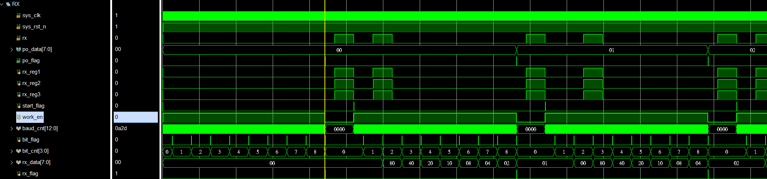
Simulation
依據各家模擬器不同，rx_reg1.2.3不一定觀察的到clock週期的延遲
起始位
停止位

Slide 20
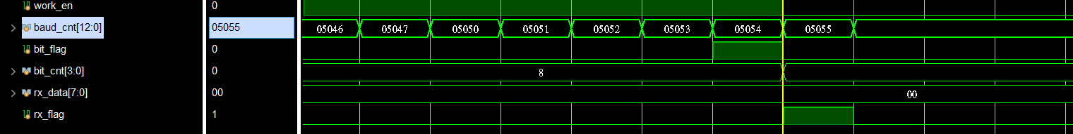
Simulation
Baud Rate計數
rx_dara 移位拼接

Slide 21
uart_tx
將Baud Rate 及時鐘週期拉出來方便更改
module uart_tx#(
parameter UART_BPS = 'd9600, // Baud Rate
parameter CLK_FREQ = 'd50_000_000 // clock period
)(
input wire sys_clk ,
input wire sys_rst_n ,
input wire [7:0] pi_data ,
input wire pi_flag ,
output reg tx
);
//localparam define
localparam BAUD_CNT_MAX = CLK_FREQ/UART_BPS ;
//reg define
reg [12:0] baud_cnt;
reg bit_flag;
reg [3:0] bit_cnt ;
reg work_en ;

Slide 22
uart_tx
將原本的parallel data轉為10位( 起始位 8bit數據位 停止位) 傳輸
// enable signal
always@(posedge sys_clk or negedge sys_rst_n)
if(sys_rst_n == 1'b0)
work_en <= 1'b0;
else if(pi_flag == 1'b1)
work_en <= 1'b1;
else if((bit_flag == 1'b1) && (bit_cnt == 4'd9))
work_en <= 1'b0;
// bit cnt 8 + 2bit
always@(posedge sys_clk or negedge sys_rst_n)
if(sys_rst_n == 1'b0)
bit_cnt <= 4'b0;
else if((bit_flag == 1'b1) && (bit_cnt == 4'd9))
bit_cnt <= 4'b0;
else if((bit_flag == 1'b1) && (work_en == 1'b1))
bit_cnt <= bit_cnt + 1'b1;

Slide 23
uart_tx
Baud rate計算
// baud_cnt
always@(posedge sys_clk or negedge sys_rst_n)
if(sys_rst_n == 1'b0)
baud_cnt <= 13'b0;
else if((baud_cnt == BAUD_CNT_MAX - 1) || (work_en == 1'b0))
baud_cnt <= 13'b0;
else if(work_en == 1'b1)
baud_cnt <= baud_cnt + 1'b1;
// bit flag
always@(posedge sys_clk or negedge sys_rst_n)
if(sys_rst_n == 1'b0)
bit_flag <= 1'b0;
else if(baud_cnt == 13'd1)
bit_flag <= 1'b1;
else
bit_flag <= 1'b0;

Slide 24
uart_tx
利用case 將資料轉成serial傳輸
// parallel to serial
always@(posedge sys_clk or negedge sys_rst_n)
if(sys_rst_n == 1'b0)
tx <= 1'b1;
else if(bit_flag == 1'b1)
case(bit_cnt)
0 : tx <= 1'b0;
1 : tx <= pi_data[0];
2 : tx <= pi_data[1];
3 : tx <= pi_data[2];
4 : tx <= pi_data[3];
5 : tx <= pi_data[4];
6 : tx <= pi_data[5];
7 : tx <= pi_data[6];
8 : tx <= pi_data[7];
9 : tx <= 1'b1;
default : tx <= 1'b1;
endcase
endmodule

Slide 25
tb_uart_tx
一樣需要模擬輸入資料
module tb_uart_tx();
//reg define
reg sys_clk;
reg sys_rst_n;
reg [7:0] pi_data;
reg pi_flag;
//wire define
wire tx;
// initial
initial begin
sys_clk = 1'b1;
sys_rst_n <= 1'b0;
#20;
sys_rst_n <= 1'b1;
end

Slide 26
tb_uart_tx
每個sys_clk週期就傳一bit資料
// output [7:0]data
initial begin
pi_data <= 8'b0;
pi_flag <= 1'b0;
#200
pi_data <= 8'd0;
pi_flag <= 1'b1;
#20
pi_flag <= 1'b0;
#(5208*20*10);
pi_data <= 8'd1;
pi_flag <= 1'b1;
#20
pi_flag <= 1'b0;
#(5208*20*10);
pi_data <= 8'd2;
pi_flag <= 1'b1;
#20
pi_flag <= 1'b0;
#(5208*20*10);
pi_data <= 8'd3;
pi_flag <= 1'b1;
#20
pi_flag <= 1'b0;
#(5208*20*10);
pi_data <= 8'd4;
pi_flag <= 1'b1;
#20
pi_flag <= 1'b0;
#(5208*20*10);
pi_data <= 8'd5;
pi_flag <= 1'b1;
#20
pi_flag <= 1'b0;
#(5208*20*10);
pi_data <= 8'd6;
pi_flag <= 1'b1;
#20
pi_flag <= 1'b0;
#(5208*20*10);
pi_data <= 8'd7;
pi_flag <= 1'b1;
#20
pi_flag <= 1'b0;
end
always #10 sys_clk = ~sys_clk;

Slide 27
rs232
將之前的rx.tx實例化
module rs232(
input wire sys_clk ,
input wire sys_rst_n ,
input wire rx ,
output wire tx
);
//parameter define
parameter UART_BPS = 14'd9600;
parameter CLK_FREQ = 26'd50_000_000;
//wire define
wire [7:0] po_data;
wire po_flag;

Slide 28
rs232
//------------------------uart_rx_inst------------------------
uart_rx
#(
.UART_BPS (UART_BPS),
.CLK_FREQ (CLK_FREQ)
)
uart_rx_inst
(
.sys_clk (sys_clk ), //input sys_clk
.sys_rst_n (sys_rst_n ), //input sys_rst_n
.rx (rx ), //input rx
.po_data (po_data ), //output [7:0] po_data
.po_flag (po_flag ) //output po_flag
);

Slide 29
rs232
//------------------------uart_tx_inst------------------------
uart_tx
#(
.UART_BPS (UART_BPS),
.CLK_FREQ (CLK_FREQ)
)
uart_tx_inst
(
.sys_clk (sys_clk ), //input sys_clk
.sys_rst_n (sys_rst_n ), //input sys_rst_n
.pi_data (po_data ), //input [7:0] pi_data
.pi_flag (po_flag ), //input pi_flag
.tx (tx ) //output tx
);
endmodule

Slide 30
tb_rs232
Tb需要給生成一組隨機的輸入資料
`timescale 1ns/1ns
module tb_rs232();
reg sys_clk;
reg sys_rst_n;
reg rx;
wire tx;
initial begin
sys_clk = 1'b1;
sys_rst_n <= 1'b0;
rx <= 1'b1;
#20;
sys_rst_n <= 1'b1;
end
initial begin
#200
rx_byte();
end

Slide 31
tb_rs232
透過task來反覆傳送，0位起始 9位停止
always #10 sys_clk = ~sys_clk;
task rx_byte();
integer j;
for(j=0; j<8; j=j+1)
rx_bit(j);
endtask
task rx_bit(
input [7:0] data
);
integer i;
for(i=0; i<10; i=i+1) begin
case(i)
0: rx <= 1'b0;
1: rx <= data[0];
2: rx <= data[1];
3: rx <= data[2];
4: rx <= data[3];
5: rx <= data[4];
6: rx <= data[5];
7: rx <= data[6];
8: rx <= data[7];
9: rx <= 1'b1;
endcase
#(5208*20);
end
endtask

Slide 32
tb_rs232
實例化
//------------------------rs232_inst------------------------
rs232 rs232_inst(
.sys_clk (sys_clk ), //input sys_clk
.sys_rst_n (sys_rst_n ), //input sys_rst_n
.rx (rx ), //input rx
.tx (tx ) //output tx
);
endmodule

Slide 33
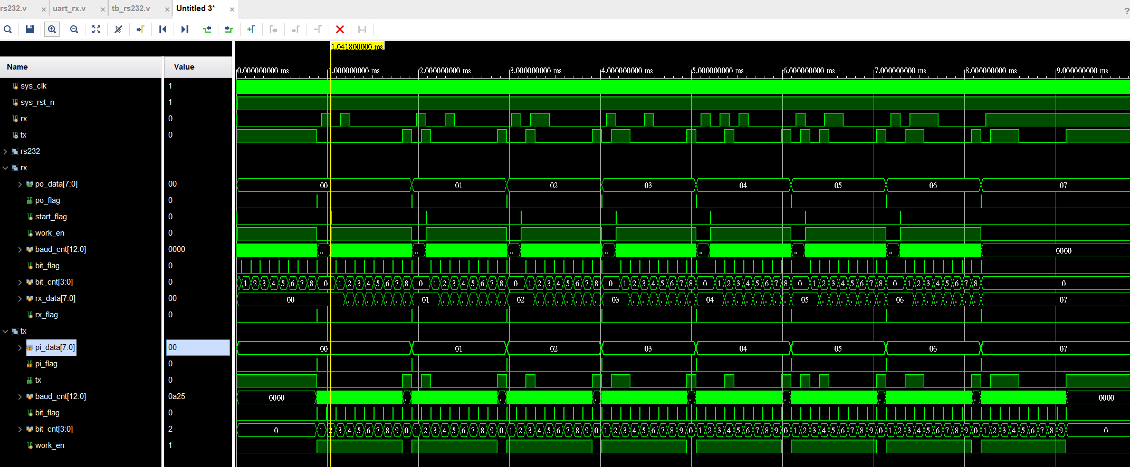
rs232

Slide 34
SPI

Slide 35
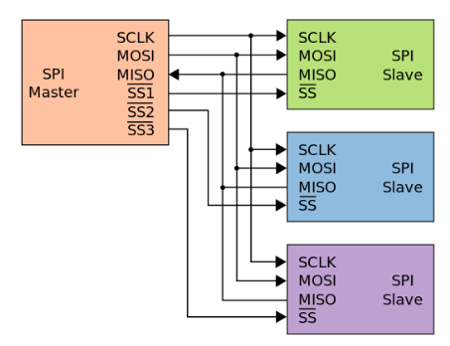
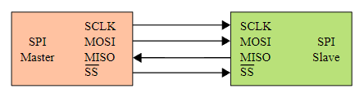
SPI overview
SPI ( Serial Periphel Interface) 為一種高速全雙工的同步通訊協議，但沒有應答機制確認數據是否接受。
SPI有主從之分，下圖例分別顯示單對單及單對多的情形
SCLK : 因為是同步通訊，所以使用的是同一組時鐘信號
MOSI : 主機輸出 / 從機輸入
MISO : 主機輸入 / 從機輸出
SS : Chip Select 有幾個從機就需要幾個訊號線

Slide 36
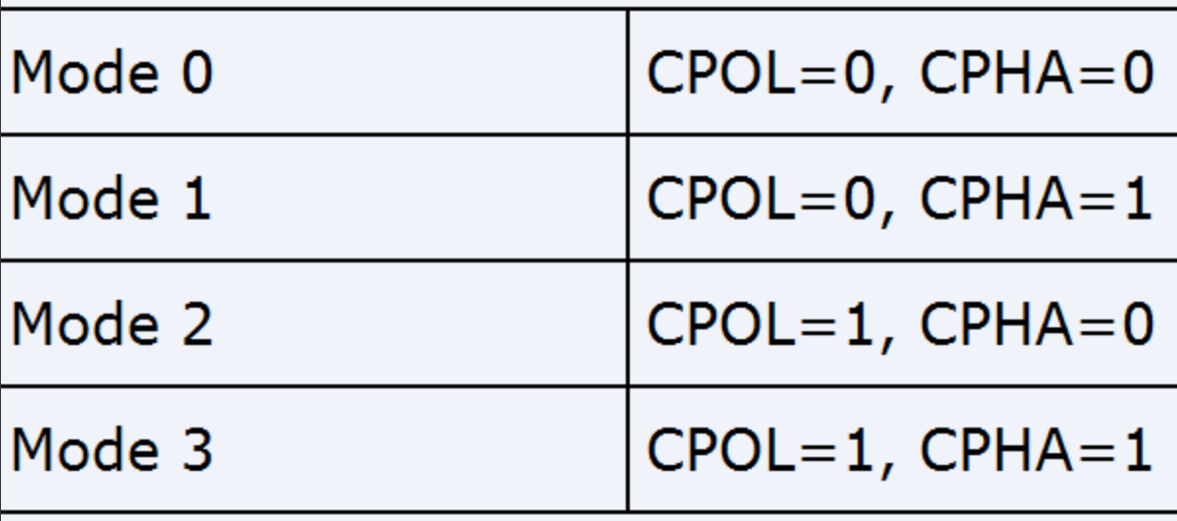
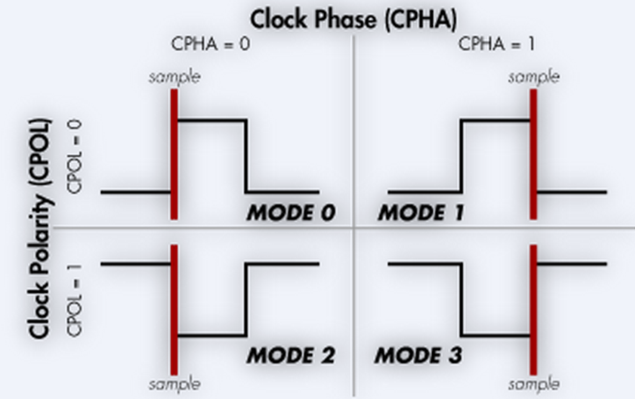
SPI 協議
實際看到協議前，會先將clock區分成極性(CPOL)及相位(CPHA)
當CPOL為0時
CPHA為0 代表奇數位採樣
CPHA為1 代表偶數位採樣
當CPOL為1時
CPHA為0 代表偶數位採樣
CPHA為1 代表奇數位採樣

Slide 37
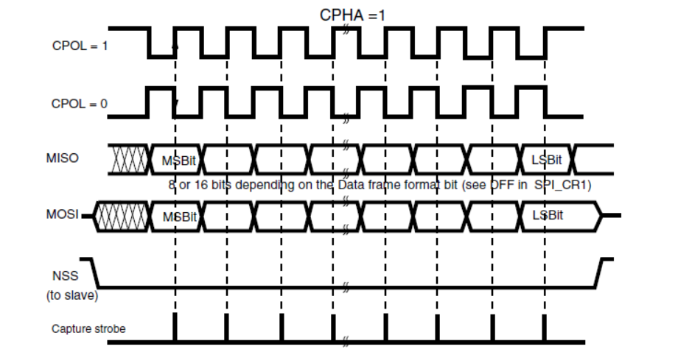
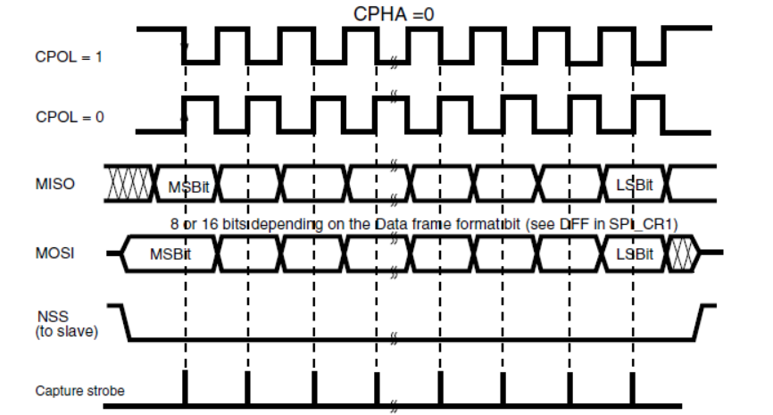
SPI 協議
可以看到四種模式的時序圖，當SS拉低認到從機時就會依據模式判定的時機抓取資料

Slide 38
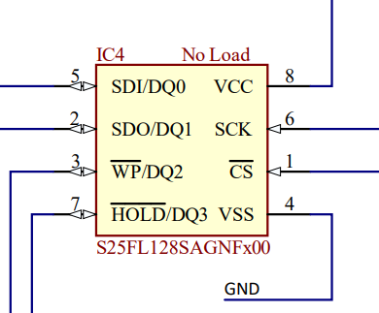
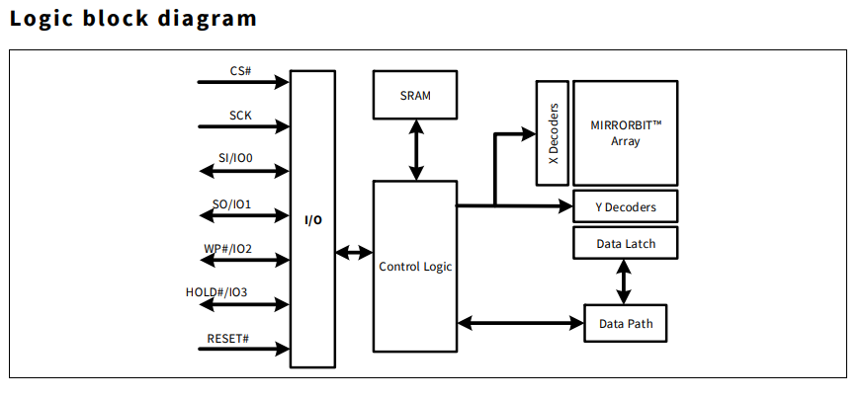
Flash_Erase
FPGA通常是透過搭配的FLASH來固化程序，所以這裡會準備幾個SPI FLASH的Lab來學習如何讀寫控制FLASH
本次Lab使用Arty S7-50 搭配的S25FL128S，相關資料參閱其Datasheet。
首先我們先將學習自己編寫程式將SPI FLASH內的資料消除

Slide 39
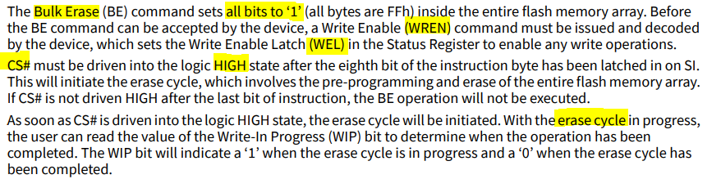
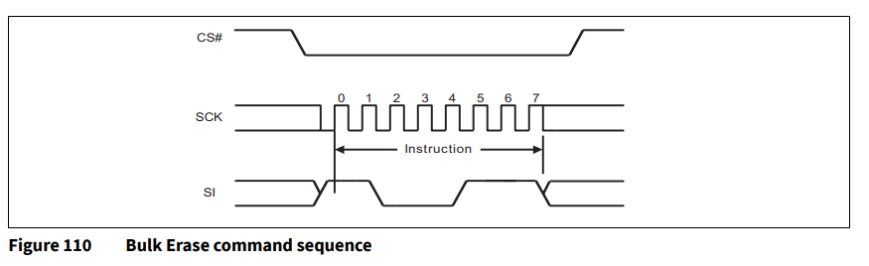
Flash_Erase
拉高WREN
進入WEL 狀態
拉低CS信號並持續
將每個bit寫為1
拉高CS信號
等待erase cycle的時間

Slide 40
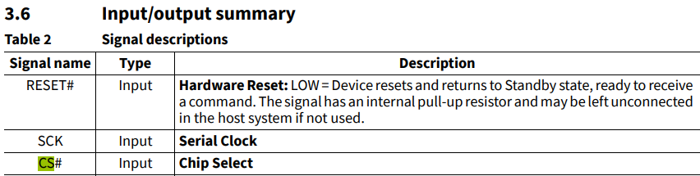
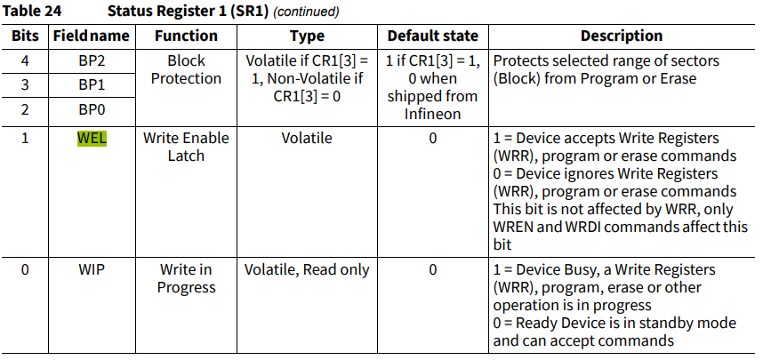
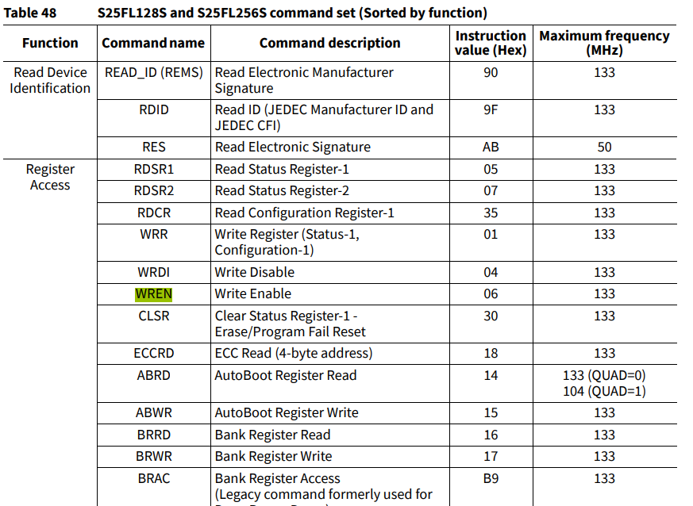
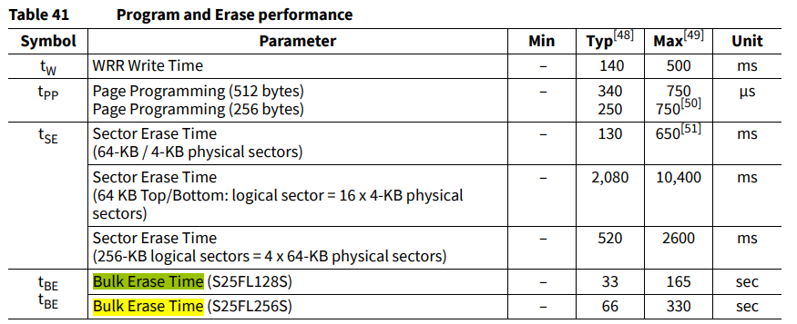
Flash_Erase

Slide 41
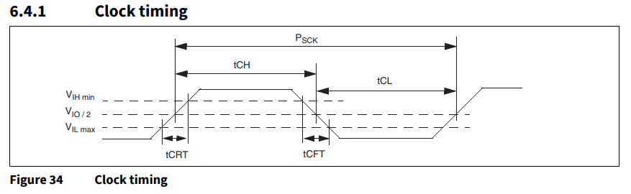
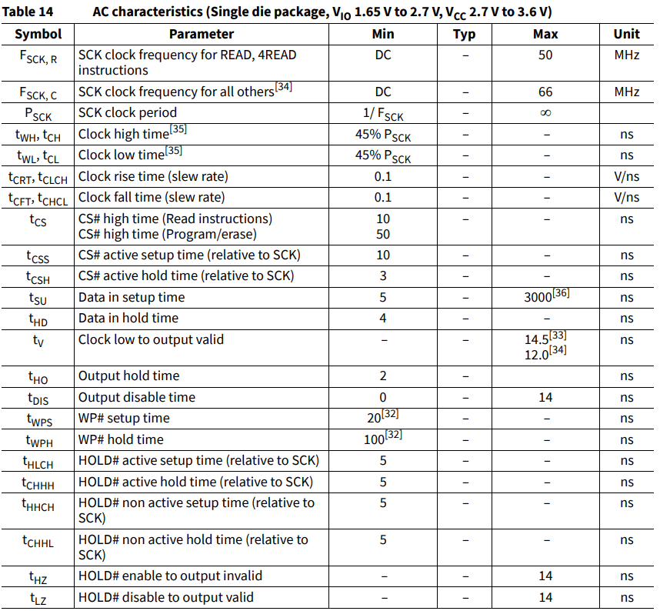
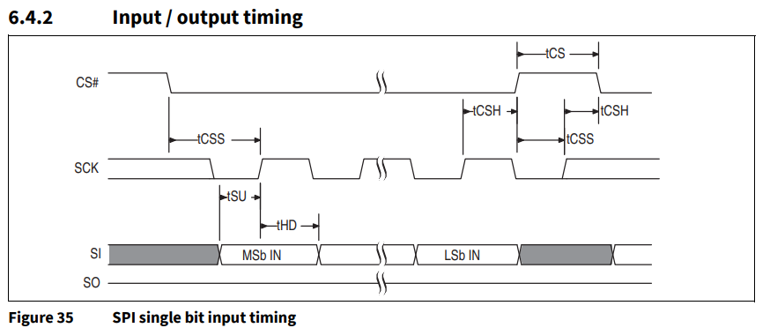
Timing

Slide 42
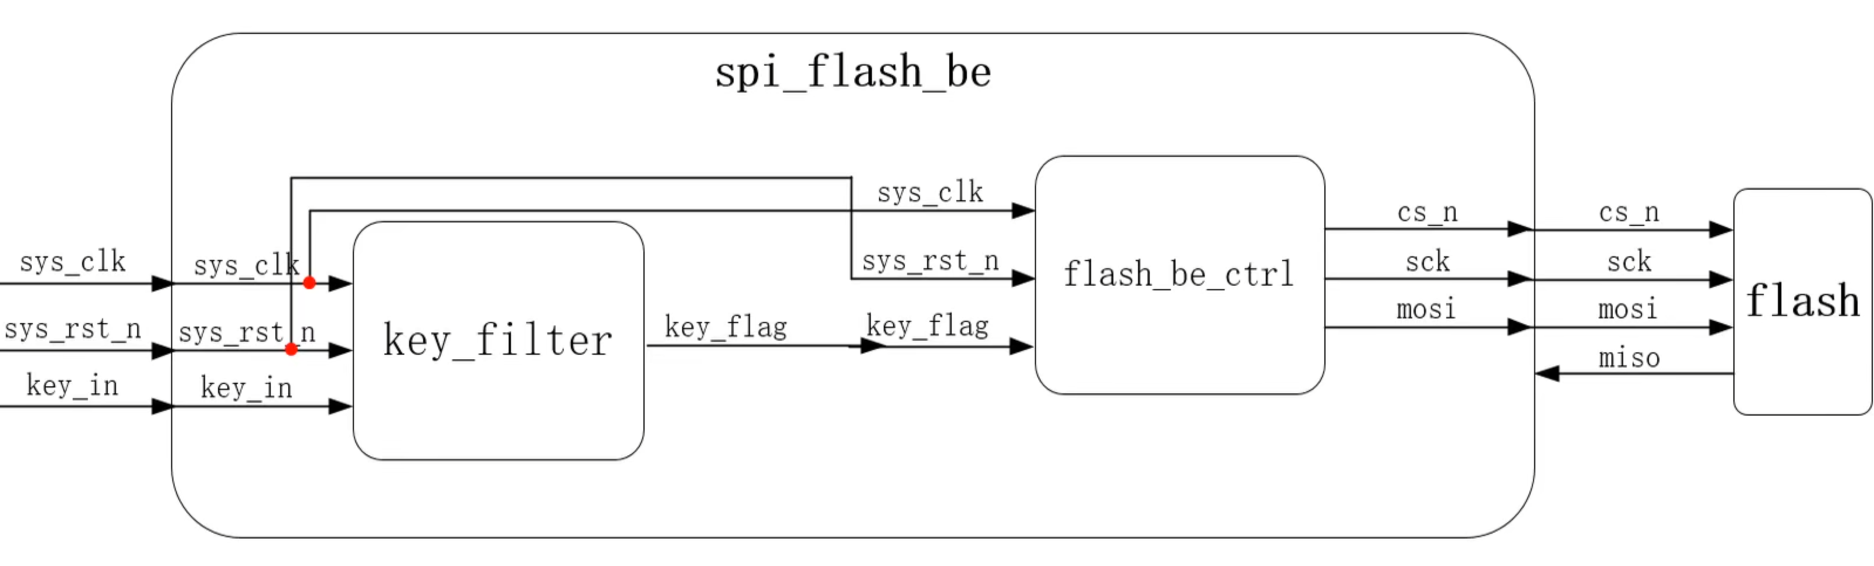
Bulk Erase Lab

Slide 43
Spi_flash_be
依據Flash Datasheet指示，若要清除Flash，需要先進寫入狀態
module flash_be_ctrl
(
input wire sys_clk ,
input wire sys_rst_n ,
input wire key , output reg cs_n ,
output reg sck ,
output reg mosi
); parameter IDLE = 4'b0001 , WR_EN = 4'b0010 , DELAY = 4'b0100 , BE = 4'b1000 ;
parameter WR_EN_INST = 8'b0000_0110, BE_INST = 8'b1100_0111;
//reg define
reg [2:0] cnt_byte; // byte counter
reg [3:0] state ; // state
reg [4:0] cnt_clk ; // sys_clk counter
reg [1:0] cnt_sck ; // serial clock counter
reg [2:0] cnt_bit ; // bit counter

Slide 44
Spi_flash_be
Sys_clk使用12.5MHz 依據Flash Datasheet給的時間計算，一個bit花費32個clk週期
// cnt_clk:
always@(posedge sys_clk or negedge sys_rst_n)
if(sys_rst_n == 1'b0)
cnt_clk <= 5'd0;
else if(state != IDLE)
cnt_clk <= cnt_clk + 1'b1;
//cnt_byte: 1byte 32 clock period
always@(posedge sys_clk or negedge sys_rst_n)
if(sys_rst_n == 1'b0)
cnt_byte <= 3'd0;
else if((cnt_clk == 5'd31) && (cnt_byte == 3'd6))
cnt_byte <= 3'd0;
else if(cnt_clk == 31)
cnt_byte <= cnt_byte + 1'b1;

Slide 45
Spi_flash_be
依據剛剛產生的flag 來產生SPI的serial clock
//cnt_sck: serial clock counter
always@(posedge sys_clk or negedge sys_rst_n)
if(sys_rst_n == 1'b0)
cnt_sck <= 2'd0;
else if((state == WR_EN) && (cnt_byte == 1'b1))
cnt_sck <= cnt_sck + 1'b1;
else if((state == BE) && (cnt_byte == 3'd5))
cnt_sck <= cnt_sck + 1'b1;
//sck: output serial clock
always@(posedge sys_clk or negedge sys_rst_n)
if(sys_rst_n == 1'b0)
sck <= 1'b0;
else if(cnt_sck == 2'd0)
sck <= 1'b0;
else if(cnt_sck == 2'd2)
sck <= 1'b1;

Slide 46
Spi_flash_be
控制cs信號來輸出mosi
//cs_n:
always@(posedge sys_clk or negedge sys_rst_n)
if(sys_rst_n == 1'b0)
cs_n <= 1'b1;
else if(key == 1'b1)
cs_n <= 1'b0;
else if((cnt_byte == 3'd2)&&(cnt_clk == 5'd31)&&(state == WR_EN))
cs_n <= 1'b1;
else if((cnt_byte == 3'd3)&&(cnt_clk == 5'd31)&&(state == DELAY))
cs_n <= 1'b0;
else if((cnt_byte == 3'd6)&&(cnt_clk == 5'd31)&&(state == BE))
cs_n <= 1'b1;
//cnt_bit:output mosi
always@(posedge sys_clk or negedge sys_rst_n)
if(sys_rst_n == 1'b0)
cnt_bit <= 3'd0;
else if(cnt_sck == 2'd2)
cnt_bit <= cnt_bit + 1'b1;

Slide 47
Spi_flash_be
狀態機 狀態轉移模塊
//state machine
always@(posedge sys_clk or negedge sys_rst_n)
if(sys_rst_n == 1'b0)
state <= IDLE;
else
case(state)
IDLE: if(key == 1'b1)
state <= WR_EN;
WR_EN: if((cnt_byte == 3'd2) && (cnt_clk == 5'd31))
state <= DELAY;
DELAY: if((cnt_byte == 3'd3) && (cnt_clk == 5'd31))
state <= BE;
BE: if((cnt_byte == 3'd6) && (cnt_clk == 5'd31))
state <= IDLE;
default: state <= IDLE;
endcase

Slide 48
Spi_flash_be
狀態機 輸出模塊
//mosi: output
always@(posedge sys_clk or negedge sys_rst_n)
if(sys_rst_n == 1'b0)
mosi <= 1'b0;
else if((state == WR_EN) && (cnt_byte == 3'd2))
mosi <= 1'b0;
else if((state == BE) && (cnt_byte == 3'd6))
mosi <= 1'b0;
else if((state == WR_EN)&&(cnt_byte == 3'd1)&&(cnt_sck == 5'd0))
mosi <= WR_EN_INST[7 - cnt_bit];
else if((state == BE) && (cnt_byte == 3'd5) && (cnt_sck == 5'd0))
mosi <= BE_INST[7 - cnt_bit];
endmodule

Slide 49
tb_flash_be_ctrl
`timescale 1ns/1ns
module tb_flash_be_ctrl();
//wire define
wire cs_n ;
wire sck ;
wire mosi ;
//reg define
reg sys_clk ;
reg sys_rst_n ;
reg key ;
initial
begin
sys_clk = 1'b1;
sys_rst_n <= 1'b0;
key <= 1'b0;
#100
sys_rst_n <= 1'b1;
#1000
key <= 1'b1;
#20
key <= 1'b0;
end
always #10 sys_clk <= ~sys_clk;
defparam memory.mem_access.initfile = "initmemory.txt";

Slide 50
tb_flash_be_ctrl
//-- flash_be_ctrl_inst -------
flash_be_ctrl flash_be_ctrl_inst
(
.sys_clk (sys_clk ),
.sys_rst_n (sys_rst_n ),
.key (key ),
.sck (sck ),
.cs_n (cs_n ),
.mosi (mosi )
);
//------------- memory -------------
m25p16 memory
(
.c (sck ),
.data_in (mosi ),
.s (cs_n ),
.w (1'b1 ),
.hold (1'b1 ),
.data_out ( )
);
endmodule

Slide 51
IIC

Slide 52
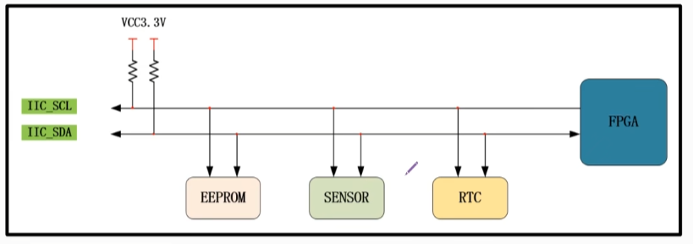
IIC overview
全稱Inter – Integrated Circuit，屬於同步雙向Serial通信接口的統稱。
而且總共只需要兩線即可傳輸 SCL負責同步 SDA負責傳輸數據
支援多主機對多從機，

Slide 53
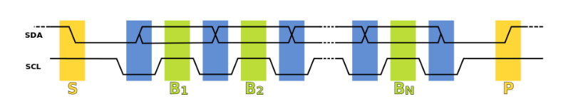
IIC 協議層
響應位
起始位
停止位

Slide 54
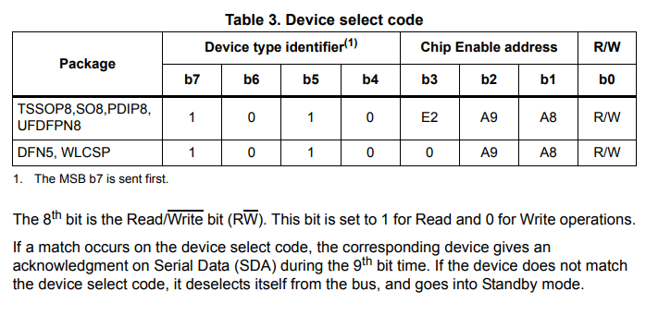
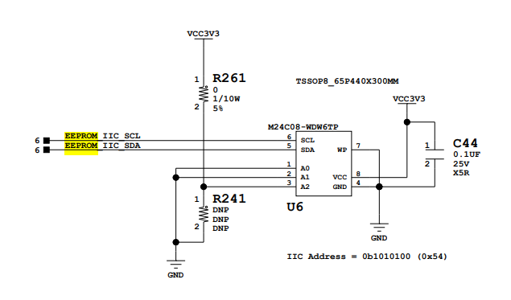
IIC Address
以AC701使用的IIC EEPROM為例，每種IIC的從機設備不同，以EEPROM來說只啟用了低3位
主機在傳輸時會先辨識從機的address，若兩相符合才拉高響應

Slide 55
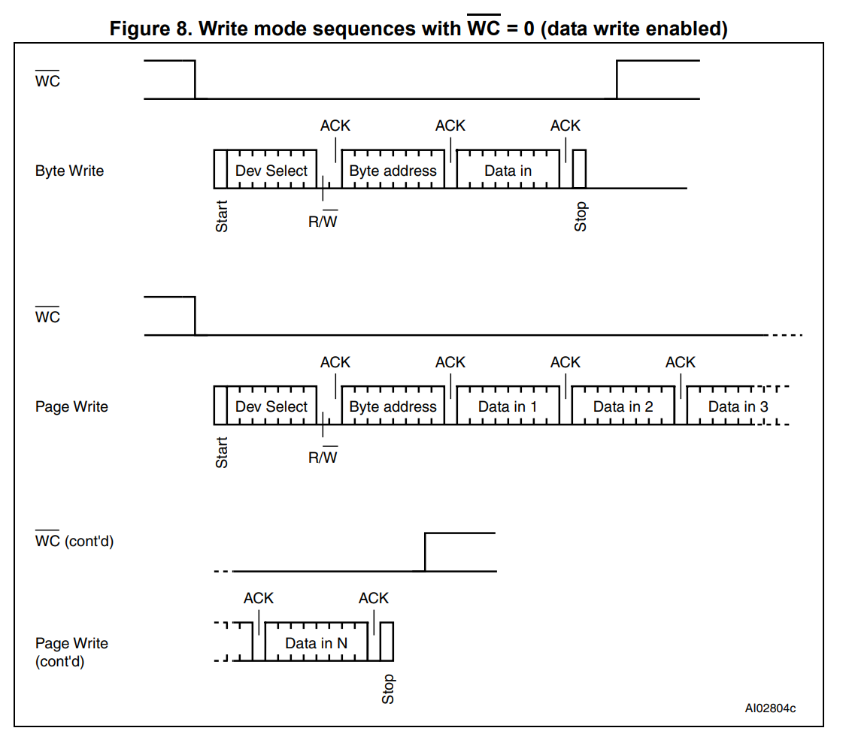
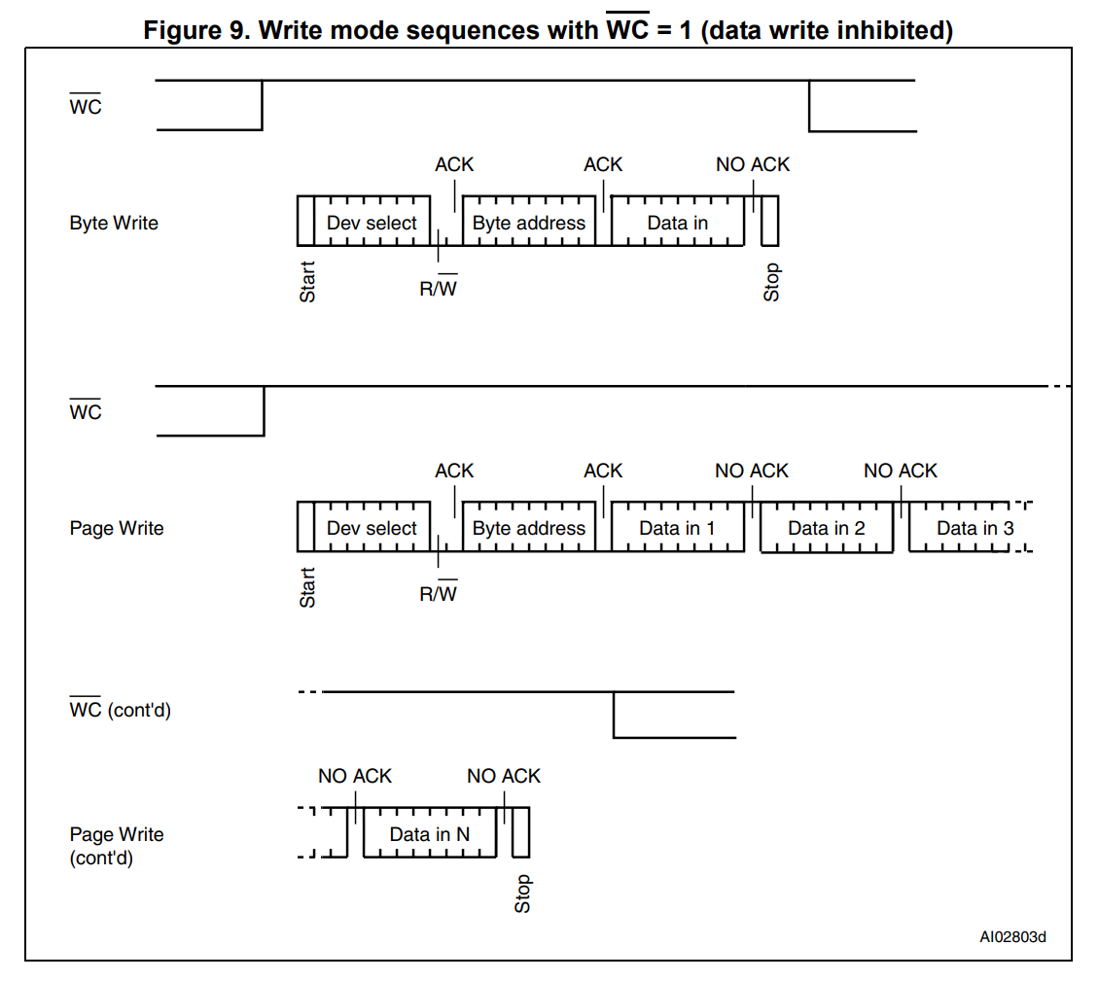
Byte Write & Page Write
Dev Select = 1010100
如果要發送複數的資料時由低位開始發送，且每次發送的中間都要響應一次

Slide 56
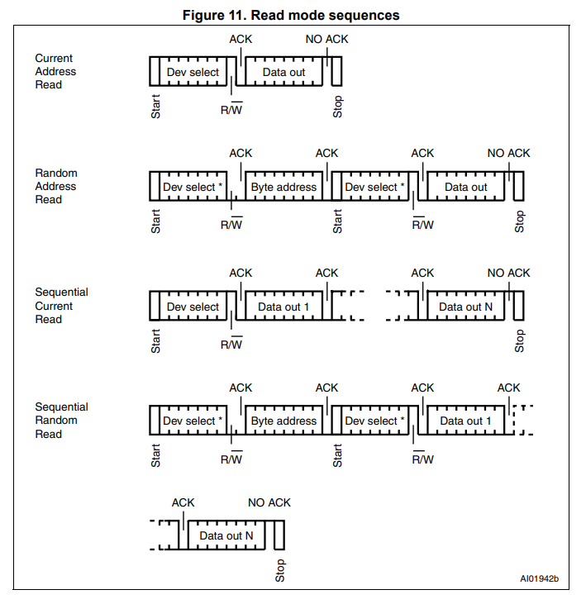
Read operations
隨機讀可以理解為單Byte的讀取，另外因為主從機需要ID辨識，所以不管是寫入還是讀取都需要先enable一次寫入將從機ID寫入。讀取完成後拉低響應再發送停止位。

Slide 57
FSM
IDLE
IDLE
Config_done
READ
WR_CHECK
WR_IIC
~Config_done

Slide 58
FSM
Wr_start
IDLE
Wr_dev
ERROR
STOP
Wr_men
Wr_data
Rd_data
Rd_start
Rd_dev

Slide 59
I2C_driver
Port define
`timescale 1ns / 1ps
module i2c_driver(
input clk,
input rst,
input wr_req,
input rd_req,
input start,
input [7:0] dev_addr,
input [7:0] mem_addr,
input [7:0] wr_data,
output reg [7:0] rd_data,
output reg rd_done,
output reg wr_done,
output reg scl,
inout sda
);

Slide 60
I2C_driver
parameter define
parameter IDLE = 9'b0_0000_0001;
parameter WR_START = 9'b0_0000_0010;
parameter WR_DEV = 9'b0_0000_0100;
parameter WR_MEM = 9'b0_0000_1000;
parameter WR_DATA = 9'b0_0001_0000;
parameter RD_START = 9'b0_0010_0000;
parameter RD_DEV = 9'b0_0100_0000;
parameter RD_DATA = 9'b0_1000_0000;
parameter STOP = 9'b1_0000_0000;
parameter SYS_CYCLE = 20; // 1/20ns = 50M
parameter IIC_CYCLE = 2500;// 1/2500ns = 400K
parameter MAX = (IIC_CYCLE/SYS_CYCLE) - 1;
parameter T_HIGH = 1000; //IIC PULL HIGH TIME
parameter T_LOW = 1500; //IIC PULL LOW TIME
parameter FLAG0 = ((T_HIGH/SYS_CYCLE)>>1) - 1; // HIGH END
parameter FLAG1 = (T_HIGH/SYS_CYCLE) - 1; // HIGH START
parameter FLAG2 = (T_HIGH/SYS_CYCLE) + ((T_LOW/SYS_CYCLE)>>1) - 1; //LOW END
parameter FLAG3 = (T_HIGH/SYS_CYCLE) + (T_LOW/SYS_CYCLE) - 1; //LOW START

Slide 61
I2C_driver
Internal signal define
reg [2:0] cnt_freq;
wire add_cnt_freq;
wire end_cnt_freq; reg [5:0] cnt_flag;
wire add_cnt_flag;
wire end_cnt_flag;
reg [5:0] x; reg [9:0] cnt;
wire add_cnt;
wire end_cnt; reg drive_flag;
reg [8:0] state;
reg work_flag;
reg wr_en;
reg [7:0] data_shift;
reg ack_flag; reg wr_sda;
wire rec_sda;
assign sda = wr_en ? wr_sda : 1'bz;
assign rec_sda = sda;

Slide 62
I2C_driver
fsm
always@(posedge clk)begin
if(rst)
state <= IDLE;
else
case(state)
IDLE:begin
if(state==1'b1 && (wr_req==1'b1 || rd_req==1'b1))
state <= WR_START;
else
state <= IDLE;
end
WR_START:begin
if(cnt_flag=='d2 && drive_flag)
state <= WR_DEV;
else
state <= WR_START;
end
WR_DEV:begin
if(cnt_flag=='d35 && drive_flag && ack_flag==1'b1)
state <= WR_MEM;
else
state <= WR_DEV;
end

Slide 63
I2C_driver
fsm
WR_MEM:begin
if(cnt_flag=='d35 && drive_flag && ack_flag==1'b1)begin
if(wr_req)
state <= WR_DATA;
else if(wr_req==1'b0 && rd_req==1'b1)
state <= RD_START;
end
else
state <= WR_MEM;
end
WR_DATA:begin
if(cnt_flag=='d35 && drive_flag && ack_flag==1'b1)
state <= STOP;
else
state <= WR_DATA;
end
RD_START:begin
if(cnt_flag=='d3 && drive_flag && rd_req)
state <= RD_DEV;
else
state <= RD_START;
end

Slide 64
I2C_driver
fsm
RD_DEV:begin
if(cnt_flag=='d35 && drive_flag && ack_flag==1'b1)
state <= RD_DATA;
else
state <= RD_DEV;
end
RD_DATA:begin
if(cnt_flag=='d35 && drive_flag && ack_flag==1'b1)
state <= STOP;
else
state <= RD_DATA;
end
STOP:begin
if(cnt_flag=='d3 && drive_flag)
state <= IDLE;
else
state <= STOP;
end
default:
state <= IDLE;
endcase
end

Slide 65
I2C_driver
Work flag & counter
always@(posedge clk)begin
if(rst)
work_flag <= 1'b0;
else if(state == WR_START)
work_flag <= 1'b1;
else if(wr_done==1'b1 || rd_done==1'b1)
work_flag <= 1'b0;
end
always@(posedge clk)begin
if(rst)
cnt <= 0;
else if(add_cnt)
cnt <= end_cnt ? 0 : cnt + 1'b1;
else
cnt <= 'd0;
end
assign add_cnt = work_flag;
assign end_cnt = add_cnt && cnt == MAX;

Slide 66
I2C_driver
Drive_flag & cnt_freq
always@(posedge clk)begin
if(rst)
drive_flag <= 1'b0;
else if(cnt==FLAG0 || cnt==FLAG1 || cnt==FLAG2 || cnt==FLAG3)
drive_flag <= 1'b1;
else
drive_flag <= 1'b0;
end
always@(posedge clk)begin
if(rst)
cnt_freq <= 1'b0;
else if(work_flag == 1'b0)
cnt_freq <= 'd0;
else if(add_cnt_freq)
cnt_freq <= end_cnt_freq ? 0 : cnt_freq + 1'b1;
else
cnt_freq <= cnt_freq;
end
assign add_cnt_freq = drive_flag;
assign end_cnt_freq = add_cnt_flag && cnt_freq == 4-1;

Slide 67
I2C_driver
Scl & counter flag
always@(posedge clk)begin
if(rst)
scl <= 1'b1;
else if(work_flag == 1'b1)
if(cnt_freq == 'd1 && drive_flag && state==STOP)
scl <= 1'b1;
if(cnt_freq == 'd1 && drive_flag && state!=STOP)
scl <= 1'b0;
else if(cnt_freq == 'd3 && drive_flag)
scl <= 1'b1;
else
scl <= 1'b1;
end always@(posedge clk)begin
if(rst)
cnt_flag <= 1'b0;
else if(work_flag == 1'b0)
cnt_freq <= 'd0;
else if(add_cnt_flag)
cnt_flag <= end_cnt_flag ? 0 : cnt_flag + 1'b1;
else
cnt_flag <= cnt_flag;
end

Slide 68
I2C_driver
State
assign add_cnt_flag = drive_flag;
assign end_cnt_flag = add_cnt_flag && cnt_freq == x; always@(*)begin
case(state)
IDLE : x = 0;
WR_START : x = 3 - 1;
WR_DEV,WR_MEM,WR_DATA,RD_DEV,RD_DATA : x = 36 - 1;
RD_START : x = 4 - 1;
STOP : x = 4 - 1;
default : x = 0;
endcase
end always@(posedge clk)begin
if(rst)
wr_en <= 1'b0;
else if(state==WR_START || state==RD_START || state==STOP)
wr_en <= 1'b1;
else if(state==WR_DEV || state==WR_MEM || state==WR_DATA || state==RD_DEV)
wr_en <= (cnt_flag < 'd32) ? 1'b1 : 1'b0;
else if(state == RD_DATA)
wr_en <= (cnt_flag < 'd32) ? 1'b0 : 1'b1;
else
wr_en <= 1'b0;
end

Slide 69
I2C_driver
Data_shift fsm
always@(posedge clk)begin
if(rst)
data_shift <= 'd0;
else begin
case(state)
IDLE :
data_shift <= 'd0;
WR_START :
data_shift <= {dev_addr[7:1],1'b0};
WR_DEV :begin
if(end_cnt_flag && ack_flag == 1'b1)
data_shift <= mem_addr;
else if(cnt_flag < 'd32 && cnt_flag[1:0]==2'd3 && drive_flag)
data_shift <= {dev_addr[6:0],1'b0};
end
WR_MEM :begin
if(end_cnt_flag && ack_flag == 1'b1 && wr_req==1'b1)
data_shift <= wr_data;
else if(cnt_flag < 'd32 && cnt_flag[1:0]==2'd3 && drive_flag)
data_shift <= {data_shift[6:0],1'b0};
end

Slide 70
I2C_driver
Data_shift fsm
WR_DATA :begin
if(cnt_flag < 'd32 && cnt_flag[1:0]==2'd3 && drive_flag)
data_shift <= {data_shift[6:0],1'b0};
else
data_shift <= data_shift;
end
RD_START :
data_shift <= {dev_addr[7:1],1'b1};
RD_DEV :begin
if(end_cnt_flag && ack_flag==1'b1)
data_shift <= 'd0;
else if(cnt_flag<'d32 && cnt_flag[1:0]==2'd3 && drive_flag)
data_shift <= {data_shift[6:0],1'b0};
end
RD_DATA :begin
if(cnt_flag<'d32 && cnt_flag[1:0]==2'd1 && drive_flag)
data_shift <= {data_shift[6:0],rec_sda};
else if(cnt_flag<'d32 && cnt_flag[1:0]==2'd3 && drive_flag)
data_shift <= data_shift;
end
default:data_shift <= data_shift;
endcase
end
end

Slide 71
I2C_driver
sda
always@(posedge clk)begin
if(rst)
wr_sda <= 1'b1;
else begin
case(state)
WR_START:begin
if(cnt_flag == 'd0 && drive_flag)
wr_sda <= 1'b0;
else
wr_sda <= wr_sda;
end
WR_DEV,WR_MEM,WR_DATA,RD_DEV:begin
wr_sda <= data_shift[7];
end
RD_START:begin
if(wr_en==1'b1 && cnt_flag=='d0)
wr_sda <= 1'b1;
else if(cnt_flag=='d1 && drive_flag)
wr_sda <= 1'b0;
end

Slide 72
I2C_driver
sda
STOP:begin
if(cnt_flag=='d0 && wr_en)
wr_sda <= 1'b0;
else if(cnt_flag=='d1 && drive_flag)
wr_sda <= 1'b1;
end
default:wr_sda <= 1'b1;
endcase
end
end

Slide 73
I2C_driver
Output done signal
always@(posedge clk)begin
if(rst)begin
wr_done <= 1'b0;
rd_done <= 1'b0;
end
else if(state==STOP && end_cnt_flag)begin
if(wr_req)
wr_done <= 1'b1;
else if(wr_req==1'b0 && rd_req==1'b1)
rd_done <= 1'b1;
end
else begin
wr_done <= 1'b0;
rd_done <= 1'b0;
end
end

Slide 74
I2C_driver
Ack_flag fsm
always@(posedge clk)begin
if(rst)
ack_flag <= 1'b0;
else begin
case(state)
WR_DEV :begin
if(cnt_flag>='d32 && cnt_flag[1:0]=='d1 && drive_flag && sda==1'b0)
ack_flag <= 1'b1;
else if(end_cnt_flag)
ack_flag <= 1'b0;
end
WR_MEM :begin
if(cnt_flag>='d32 && cnt_flag[1:0]=='d1 && drive_flag && sda==1'b0)
ack_flag <= 1'b1;
else if(end_cnt_flag)
ack_flag <= 1'b0;
end
WR_DATA :begin
if(cnt_flag>='d32 && cnt_flag[1:0]=='d1 && drive_flag && sda==1'b0)
ack_flag <= 1'b1;
else if(end_cnt_flag)
ack_flag <= 1'b0;
end

Slide 75
I2C_driver
Ack_flag fsm
RD_DEV :begin
if(cnt_flag>='d32 && cnt_flag[1:0]=='d1 && drive_flag && sda==1'b0)
ack_flag <= 1'b1;
else if(end_cnt_flag)
ack_flag <= 1'b0;
end
RD_DATA :begin
if(cnt_flag>='d32 && cnt_flag[1:0]=='d1 && drive_flag && sda==1'b0)
ack_flag <= 1'b1;
else if(end_cnt_flag)
ack_flag <= 1'b0;
end
default:
ack_flag <= 1'b0;
endcase
end
end

Slide 76
I2C_driver
Ack_flag fsm
RD_DEV :begin
if(cnt_flag>='d32 && cnt_flag[1:0]=='d1 && drive_flag && sda==1'b0)
ack_flag <= 1'b1;
else if(end_cnt_flag)
ack_flag <= 1'b0;
end
RD_DATA :begin
if(cnt_flag>='d32 && cnt_flag[1:0]=='d1 && drive_flag && sda==1'b0)
ack_flag <= 1'b1;
else if(end_cnt_flag)
ack_flag <= 1'b0;
end
default:
ack_flag <= 1'b0;
endcase
end
end
always@(posedge clk)begin
if(rst)
rd_data <= 1'b0;
else
rd_data <= rd_done ? data_shift : rd_data;
end

Slide 77
I2C_driver
Ila inst
wire [63:0] probe0;
assign probe0 = {
sda ,
wr_req ,
scl ,
wr_done ,
wr_sda ,
ack_flag,
state ,
dev_addr,
mem_addr,
wr_data ,
rd_data
};
ila_0 inst_ila0(
.clk (clk),
.probe0 (probe0)
);
endmodule

Slide 78
I2C_cfg
Port & parameter define
`timescale 1ns / 1ps
module i2c_cfg(
input clk,
input rst_n,
output scl,
inout sda
);
parameter IDLE = 6'b00001;
parameter WR_CHECK = 6'b00001;
parameter WRITE = 6'b00001;
parameter WAIT = 6'b00001;
parameter READ = 6'b00001;
parameter SYS_CYCLE = 20; // 1/20ns = 50M
parameter WAIT_TIME = 20000000;
parameter MAX_WAIT = WAIT_TIME/SYS_CYCLE - 1;

Slide 79
I2C_cfg
Internal signal
reg rd_req ;
wire rd_done ;
wire [7:0] rd_data ;
reg wr_req ;
wire wr_done ;
wire [7:0] wr_data ;
wire [7:0] dev_addr ;
wire [7:0] mem_addr ;
wire error ;
reg [24:0] cnt_wait ;
reg ready ;
reg [5:0] state ;
reg [8:0] wr_index ;
reg [8:0] rd_index ;
reg [23:0] lut_data ;
reg cfg_done ;
reg start ;
wire rst ;
assign rst = ~rst_n;

Slide 80
I2C_cfg
fsm
always@(posedge clk)begin
if(rst)
state <= IDLE;
else begin
case(state)
IDLE:
state <= WR_CHECK;
WR_CHECK: begin
if(cfg_done==1'b0 && ready)
state <= WRITE;
else if(cfg_done)
state <= WAIT;
end
WRITE: begin
if(wr_done)
state <= WR_CHECK;
else if(cfg_done)
state <= WR_CHECK;
else
state <= WRITE;
end

Slide 81
I2C_cfg
fsm
WAIT: begin
if(cfg_done && ready)
state <= READ;
else
state <= WAIT;
end
READ: begin
if(rd_done)
state <= IDLE;
else
state <= READ;
end
default:state <= IDLE;
endcase
end
end

Slide 82
I2C_cfg
Counter & ready signal
always@(posedge clk)begin
if(rst)
cnt_wait <= 'd0;
else if(state==WR_CHECK || state==WAIT)
cnt_wait <= (cnt_wait==MAX_WAIT) ? 'd0 : cnt_wait + 1'b1;
else if(start)
cnt_wait <= 'd0;
end
always@(posedge clk)begin
if(rst)
ready <= 1'b0;
else if(state==WR_CHECK || state==WAIT)
ready <= (cnt_wait==MAX_WAIT) ? 1'b1 : ready;
else if(start)
ready <= 1'b0;
end

Slide 83
I2C_cfg
Eeprom lut_data
always@(posedge clk)begin
if(rst)
lut_data <= 'ha00100;
else if(cfg_done)begin
case(wr_index)
8'd0 : lut_data <= 'ha0_00_00;
8'd1 : lut_data <= 'ha0_01_01;
8'd2 : lut_data <= 'ha0_02_02;
8'd3 : lut_data <= 'ha0_03_03;
8'd4 : lut_data <= 'ha0_04_04;
8'd5 : lut_data <= 'ha0_05_05;
8'd6 : lut_data <= 'ha0_06_06;
8'd7 : lut_data <= 'ha0_07_07;
8'd8 : lut_data <= 'ha0_08_08;
8'd9 : lut_data <= 'ha0_09_09;
8'd10 : lut_data <= 'ha0_0A_0A;
8'd11 : lut_data <= 'ha0_0B_0B;
8'd12 : lut_data <= 'ha0_0C_0C;
8'd13 : lut_data <= 'ha0_0D_0D;
8'd14 : lut_data <= 'ha0_0E_0E;
8'd15 : lut_data <= 'ha0_0F_0F;
8'd16 : lut_data <= 'ha0_10_10;
8'd17 : lut_data <= 'ha0_11_11;
8'd18 : lut_data <= 'ha0_12_12;
8'd19 : lut_data <= 'ha0_13_13;
8'd20 : lut_data <= 'ha0_14_14;
8'd21 : lut_data <= 'ha0_15_15;
8'd22 : lut_data <= 'ha0_16_16;
8'd23 : lut_data <= 'ha0_17_17;
8'd24 : lut_data <= 'ha0_18_18;
8'd25 : lut_data <= 'ha0_19_19;
8'd26 : lut_data <= 'ha0_1A_1A;
8'd27 : lut_data <= 'ha0_1B_1B;
8'd28 : lut_data <= 'ha0_1C_1C;
8'd29 : lut_data <= 'ha0_1D_1D;
8'd30 : lut_data <= 'ha0_1E_1E;
default : lut_data <= 'hFFFFFF;
endcase
end

Slide 84
I2C_cfg
Eeprom lut_data
else if(cfg_done)begin
case(rd_index)
8'd0 : lut_data <= 'ha0_00_00;
8'd1 : lut_data <= 'ha0_01_01;
8'd2 : lut_data <= 'ha0_02_02;
8'd3 : lut_data <= 'ha0_03_03;
8'd4 : lut_data <= 'ha0_04_04;
8'd5 : lut_data <= 'ha0_05_05;
8'd6 : lut_data <= 'ha0_06_06;
8'd7 : lut_data <= 'ha0_07_07;
8'd8 : lut_data <= 'ha0_08_08;
8'd9 : lut_data <= 'ha0_09_09;
8'd10 : lut_data <= 'ha0_0A_0A;
8'd11 : lut_data <= 'ha0_0B_0B;
8'd12 : lut_data <= 'ha0_0C_0C;
8'd13 : lut_data <= 'ha0_0D_0D;
8'd14 : lut_data <= 'ha0_0E_0E;
8'd15 : lut_data <= 'ha0_0F_0F;
8'd16 : lut_data <= 'ha0_10_10;
8'd17 : lut_data <= 'ha0_11_11;
8'd18 : lut_data <= 'ha0_12_12;
8'd19 : lut_data <= 'ha0_13_13;
8'd20 : lut_data <= 'ha0_14_14;
8'd21 : lut_data <= 'ha0_15_15;
8'd22 : lut_data <= 'ha0_16_16;
8'd23 : lut_data <= 'ha0_17_17;
8'd24 : lut_data <= 'ha0_18_18;
8'd25 : lut_data <= 'ha0_19_19;
8'd26 : lut_data <= 'ha0_1A_1A;
8'd27 : lut_data <= 'ha0_1B_1B;
8'd28 : lut_data <= 'ha0_1C_1C;
8'd29 : lut_data <= 'ha0_1D_1D;
8'd30 : lut_data <= 'ha0_1E_1E;
default : lut_data <= 'hFFFFFF;
endcase
end
End
assign {dev_addr,mem_addr,wr_data} = lut_data;

Slide 85
I2C_cfg
Wr & rd index
always@(posedge clk)begin
if(rst)
wr_index <= 'd0;
else if(cfg_done)
wr_index <= 'd0;
else if(wr_done && cfg_done==1'b0)
wr_index <= wr_index + 1'b1;
else
wr_index <= wr_index;
end
always@(posedge clk)begin
if(rst)
rd_index <= 'd0;
else if(dev_addr==8'hff)
rd_index <= rd_index;
else if(rd_done && cfg_done==1'b1)
rd_index <= rd_index + 1'b1;
else
rd_index <= rd_index;
end

Slide 86
I2C_cfg
Wr & rd req
always@(posedge clk)begin
if(rst)
wr_req <= 1'b0;
else if(cfg_done)
wr_req <= 1'b0;
else if(wr_done)
wr_req <= 1'b0;
else if(state==WR_CHECK && cfg_done==1'b0 && ready && dev_addr!=8'hff)
wr_req <= 1'b1;
else
wr_req <= wr_req;
end always@(posedge clk)begin
if(rst)
rd_req <= 1'b0;
else if(dev_addr==8'hff && state==WAIT)
rd_req <= 1'b0;
else if(rd_done)
rd_req <= 1'b0;
else if(cfg_done && ready && dev_addr!=8'hff && state==WAIT)
rd_req <= 1'b1;
else
rd_req <= rd_req;
end

Slide 87
I2C_cfg
done
always@(posedge clk)begin
if(rst)
cfg_done <= 1'b0;
else if(dev_addr==8'hff)
cfg_done <= 1'b1;
end
always@(posedge clk)begin
if(rst)
start <= 1'b0;
else if(state==WR_CHECK && cfg_done==1'b0 && ready && dev_addr!=8'hff)
start <= 1'b1;
else if(cfg_done && ready && state==WAIT && dev_addr!=8'hff)
start <= 1'b1;
else
start <= 1'b0;
end

Slide 88
I2C_cfg
Driver inst
i2c_driver inst_i2c_driver(
.clk (clk),
.rst (rst),
.wr_req (wr_req),
.rd_req (rd_req),
.start (start),
.dev_addr (dev_addr),
.mem_addr (mem_addr),
.wr_data (wr_data),
.rd_data (rd_data),
.rd_done (rd_done),
.wr_done (wr_done),
.scl (scl),
.sda (sda)
);
wire [127:0] probe0;

Slide 89
I2C_cfg
ila inst
assign probe0 = {
rd_done ,
wr_done ,
cfg_done,
wr_req ,
rd_req ,
state ,
rd_index,
wr_index,
rd_data ,
wr_data ,
lut_data
};
ila_i2c inst_ila_i2c(
.clk (clk),
.probe0 (probe0)
);
endmodule

Slide 90
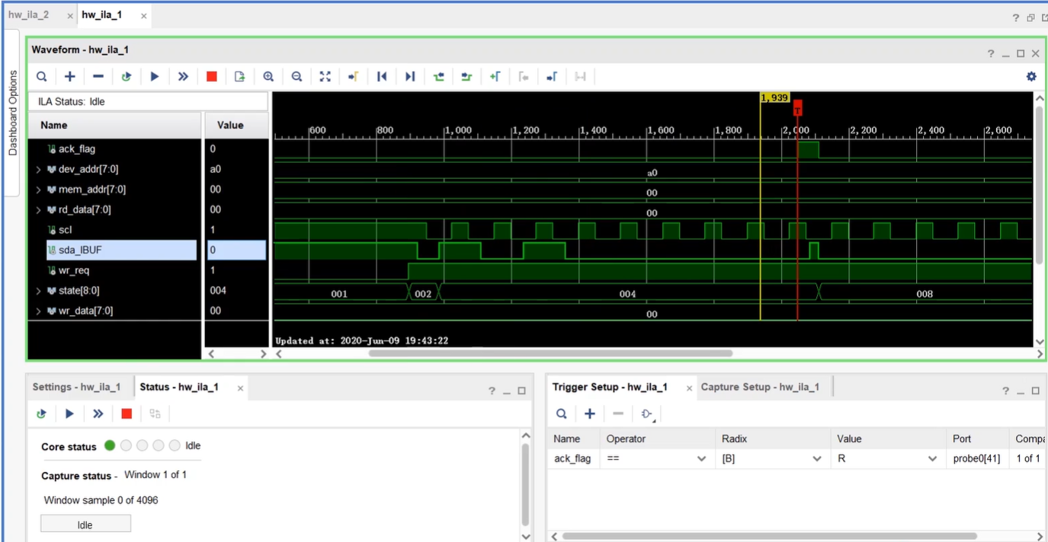
ila
響應拉高 代表停止辨識
開始辨識device arrdess

Slide 91
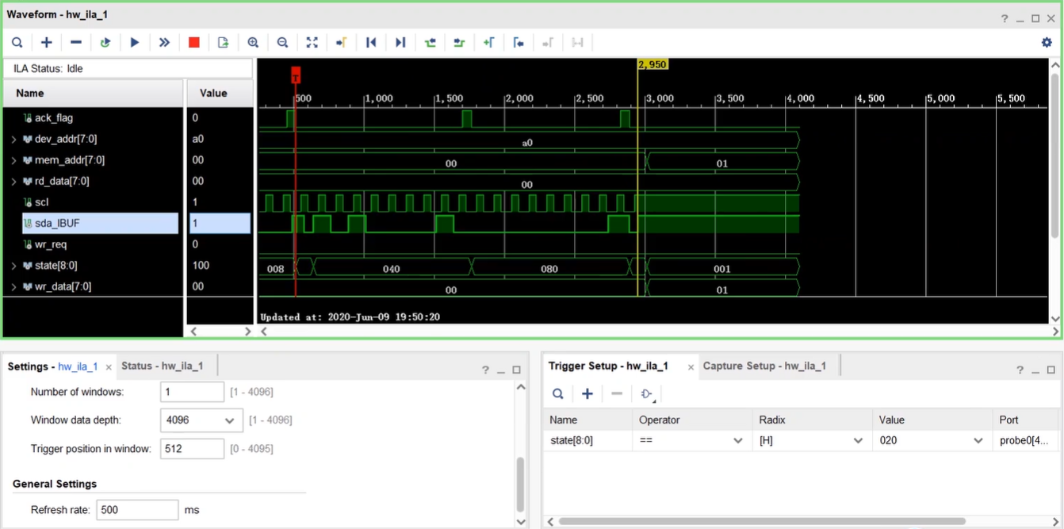
ila
響應拉高 停止讀取
開始讀取

